Slide 1

SRM INSTITUTE OF SCIENCE AND TECHNOLOGY
Ramapuram , Chennai – 600 089
DEPARTMENT OF COMPUTER SCIENCE AND ENGINEERING
21CSC305P/ MACHINE LEARNING
Multimodal Machine Learning Framework for Early Warning of Dissolved-Oxygen Deterioration in Rivers
BATCH NUMBER : 15
Team Members | Supervisor
Jackroshan J – RA2411003020031 Yagnesh C – RA2411003020036 Kirithikji – RA2411003020044 | Dr. Sahaya Sakila.V, ME., Ph.D. Assistant Professor

Slide 2
ABSTRACT
Dissolved-oxygen (DO) depletion (DO < 5 mg/L) is the primary indicator of riverine hypoxia and ecological collapse, yet traditional monitoring only flags deterioration after threshold violations occur. Proposed Framework is a multimodal machine-learning system for early warning of DO deterioration events at operational forecast horizons of H ∈ {6, 12, 24, 48} hours. The Multimodal Data Integration Integrates hourly in-situ water sensors (USGS NWIS), reanalysis weather (ERA5), and atmospheric composition (CAMS) across 15 hypoxia-prone river stations (2023–2025; 337,248 hourly records). The Methodology is 115 strictly causal features; binary event-onset classification under heavy class imbalance (1.14%–7.54% positive rate); comparison of early-fusion LightGBM classifiers against a logistic-regression stacked late-fusion ensemble. Strict temporal split with frozen parameters evaluated once on an independent 2025 hold-out year; SHAP-based global and local interpretability. The Key Findings are Auxiliary weather and air modalities provided no statistically significant performance boost over in-situ water quality alone. However, the machine learning models extended warning lead times by +4 to +9 hours at 24 h and 48 h horizons compared to conventional threshold alerts.

Slide 3
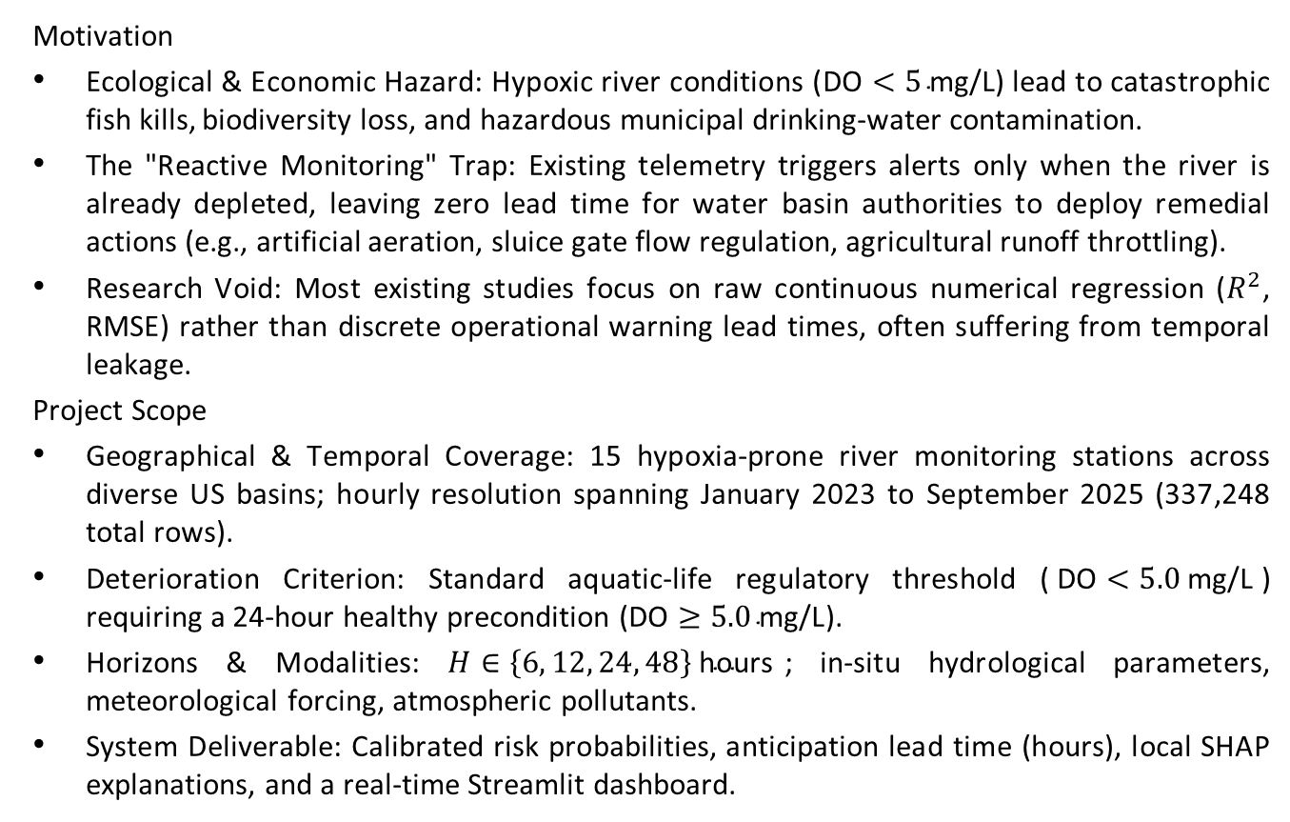
Scope and Motivation
Motivation
Ecological & Economic Hazard: Hypoxic river conditions ($\text{DO}<5\text{ mg/L}$) lead to catastrophic fish kills, biodiversity loss, and hazardous municipal drinking-water contamination.
The "Reactive Monitoring" Trap: Existing telemetry triggers alerts only when the river is already depleted, leaving zero lead time for water basin authorities to deploy remedial actions (e.g., artificial aeration, sluice gate flow regulation, agricultural runoff throttling).
Research Void: Most existing studies focus on raw continuous numerical regression ($R^{2}$, RMSE) rather than discrete operational warning lead times, often suffering from temporal leakage.
Project Scope
Geographical & Temporal Coverage: 15 hypoxia-prone river monitoring stations across diverse US basins; hourly resolution spanning January 2023 to September 2025 (337,248 total rows).
Deterioration Criterion: Standard aquatic-life regulatory threshold ($\text{DO}<5.0\text{ mg/L}$) requiring a 24-hour healthy precondition ($\text{DO}≥5.0\text{ mg/L}$).
Horizons & Modalities: $H∈\left\{6 , 12 , 24 , 48\right\}\text{ hours}$; in-situ hydrological parameters, meteorological forcing, atmospheric pollutants.
System Deliverable: Calibrated risk probabilities, anticipation lead time (hours), local SHAP explanations, and a real-time Streamlit dashboard.

Slide 4
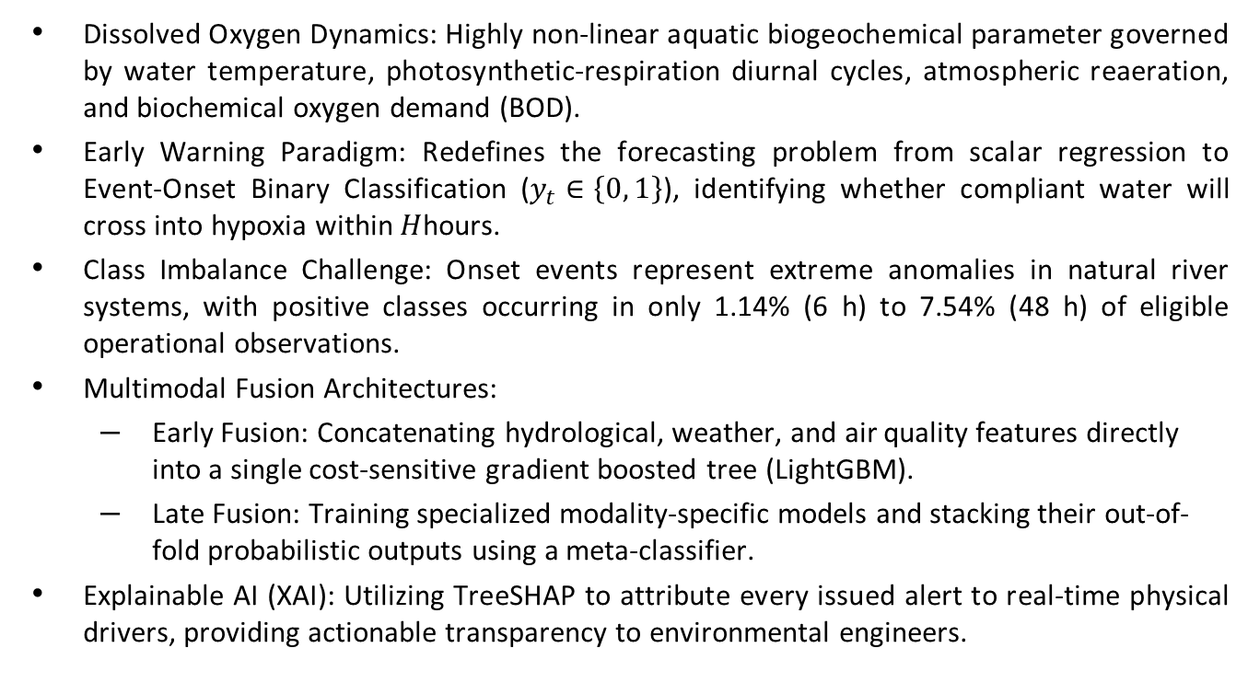
Introduction
Dissolved Oxygen Dynamics: Highly non-linear aquatic biogeochemical parameter governed by water temperature, photosynthetic-respiration diurnal cycles, atmospheric reaeration, and biochemical oxygen demand (BOD).
Early Warning Paradigm: Redefines the forecasting problem from scalar regression to Event-Onset Binary Classification ($y_{t}∈\left\{0 , 1\right\}$), identifying whether compliant water will cross into hypoxia within $H$hours.
Class Imbalance Challenge: Onset events represent extreme anomalies in natural river systems, with positive classes occurring in only 1.14% (6 h) to 7.54% (48 h) of eligible operational observations.
Multimodal Fusion Architectures:
  Early Fusion: Concatenating hydrological, weather, and air quality features directly into a single cost-sensitive gradient boosted tree (LightGBM).
  Late Fusion: Training specialized modality-specific models and stacking their out-of-fold probabilistic outputs using a meta-classifier.
Explainable AI (XAI): Utilizing TreeSHAP to attribute every issued alert to real-time physical drivers, providing actionable transparency to environmental engineers.

Slide 5
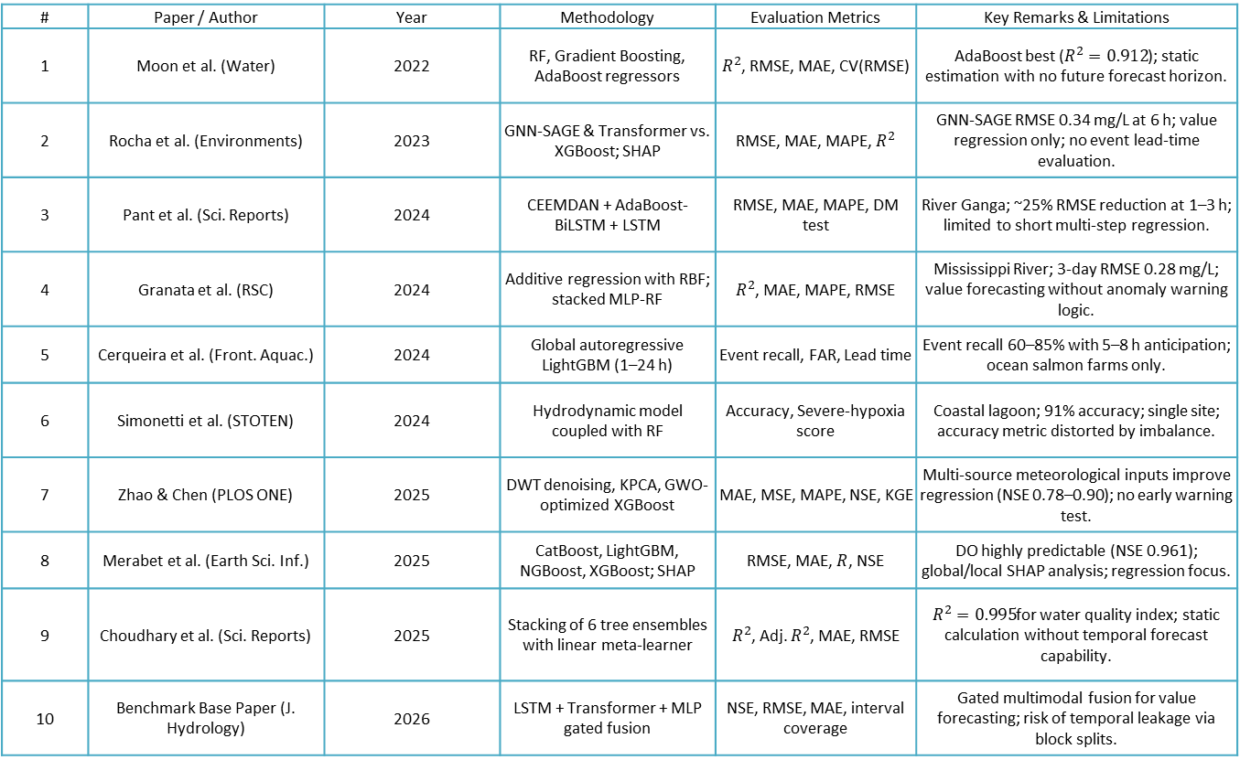
Literature Survey
# | Paper / Author | Year | Methodology | Evaluation Metrics | Key Remarks & Limitations
1 | Moon et al. (Water) | 2022 | RF, Gradient Boosting, AdaBoost regressors | $R^{2}$, RMSE, MAE, CV(RMSE) | AdaBoost best ($R^{2}=0.912$); static estimation with no future forecast horizon.
2 | Rocha et al. (Environments) | 2023 | GNN-SAGE & Transformer vs. XGBoost; SHAP | RMSE, MAE, MAPE, $R^{2}$ | GNN-SAGE RMSE 0.34 mg/L at 6 h; value regression only; no event lead-time evaluation.
3 | Pant et al. (Sci. Reports) | 2024 | CEEMDAN + AdaBoost-BiLSTM + LSTM | RMSE, MAE, MAPE, DM test | River Ganga; ~25% RMSE reduction at 1–3 h; limited to short multi-step regression.
4 | Granata et al. (RSC) | 2024 | Additive regression with RBF; stacked MLP-RF | $R^{2}$, MAE, MAPE, RMSE | Mississippi River; 3-day RMSE 0.28 mg/L; value forecasting without anomaly warning logic.
5 | Cerqueira et al. (Front. Aquac.) | 2024 | Global autoregressive LightGBM (1–24 h) | Event recall, FAR, Lead time | Event recall 60–85% with 5–8 h anticipation; ocean salmon farms only.
6 | Simonetti et al. (STOTEN) | 2024 | Hydrodynamic model coupled with RF | Accuracy, Severe-hypoxia score | Coastal lagoon; 91% accuracy; single site; accuracy metric distorted by imbalance.
7 | Zhao & Chen (PLOS ONE) | 2025 | DWT denoising, KPCA, GWO-optimized XGBoost | MAE, MSE, MAPE, NSE, KGE | Multi-source meteorological inputs improve regression (NSE 0.78–0.90); no early warning test.
8 | Merabet et al. (Earth Sci. Inf.) | 2025 | CatBoost, LightGBM, NGBoost, XGBoost; SHAP | RMSE, MAE, $R$, NSE | DO highly predictable (NSE 0.961); global/local SHAP analysis; regression focus.
9 | Choudhary et al. (Sci. Reports) | 2025 | Stacking of 6 tree ensembles with linear meta-learner | $R^{2}$, Adj. $R^{2}$, MAE, RMSE | $R^{2}=0.995$for water quality index; static calculation without temporal forecast capability.
10 | Benchmark Base Paper (J. Hydrology) | 2026 | LSTM + Transformer + MLP gated fusion | NSE, RMSE, MAE, interval coverage | Gated multimodal fusion for value forecasting; risk of temporal leakage via block splits.

Slide 6
Problem Statement
Operational Blindspot: Standard river water-quality monitoring detects hypoxia only post-occurrence, preventing preemptive ecological intervention.
Shortcomings in Prior Art:
  Task Mismatch: Existing literature focuses predominantly on continuous DO value prediction (minimizing RMSE/MAE) rather than alerting to discrete threshold-crossing event onsets.
  Evaluation Flaws: Common cross-validation or random/block splits introduce temporal data leakage, creating artificially optimistic accuracy.
  Unquantified Multimodality: The assumption that auxiliary atmospheric/weather data improves DO forecasting is rarely verified via rigorous modality ablation.

Slide 7
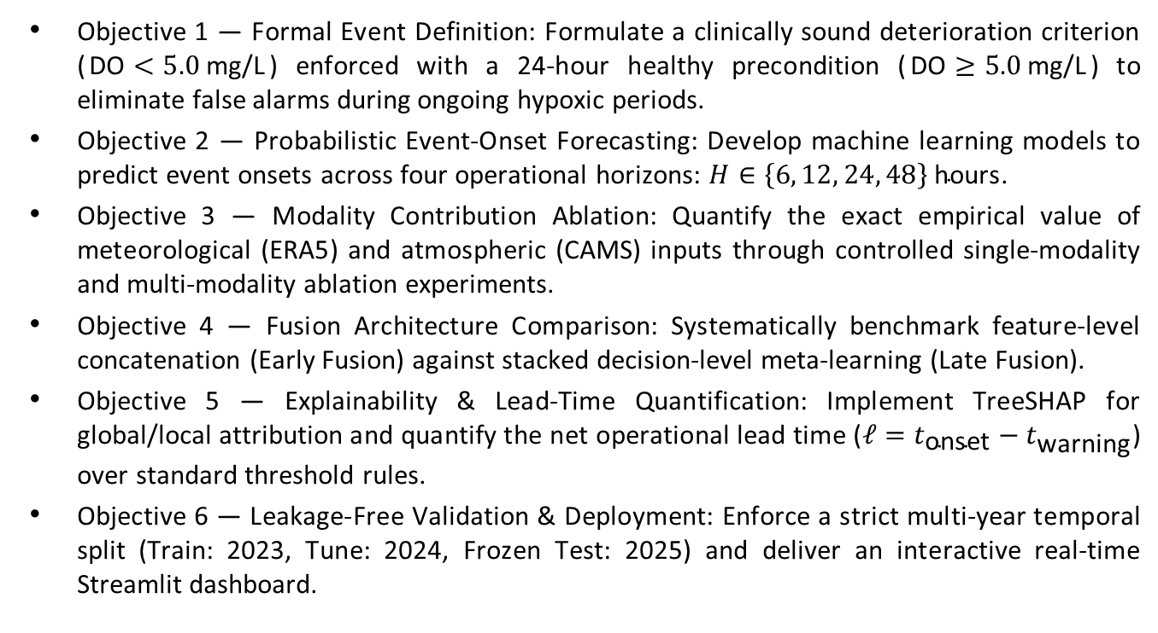
Objectives
Objective 1 — Formal Event Definition: Formulate a clinically sound deterioration criterion ($\text{DO}<5.0\text{ mg/L}$) enforced with a 24-hour healthy precondition ($\text{DO}≥5.0\text{ mg/L}$) to eliminate false alarms during ongoing hypoxic periods.
Objective 2 — Probabilistic Event-Onset Forecasting: Develop machine learning models to predict event onsets across four operational horizons: $H∈\left\{6 , 12 , 24 , 48\right\}\text{ hours}$.
Objective 3 — Modality Contribution Ablation: Quantify the exact empirical value of meteorological (ERA5) and atmospheric (CAMS) inputs through controlled single-modality and multi-modality ablation experiments.
Objective 4 — Fusion Architecture Comparison: Systematically benchmark feature-level concatenation (Early Fusion) against stacked decision-level meta-learning (Late Fusion).
Objective 5 — Explainability & Lead-Time Quantification: Implement TreeSHAP for global/local attribution and quantify the net operational lead time ($ℓ=t_{\text{onset}}−t_{\text{warning}}$) over standard threshold rules.
Objective 6 — Leakage-Free Validation & Deployment: Enforce a strict multi-year temporal split (Train: 2023, Tune: 2024, Frozen Test: 2025) and deliver an interactive real-time Streamlit dashboard.

Slide 8
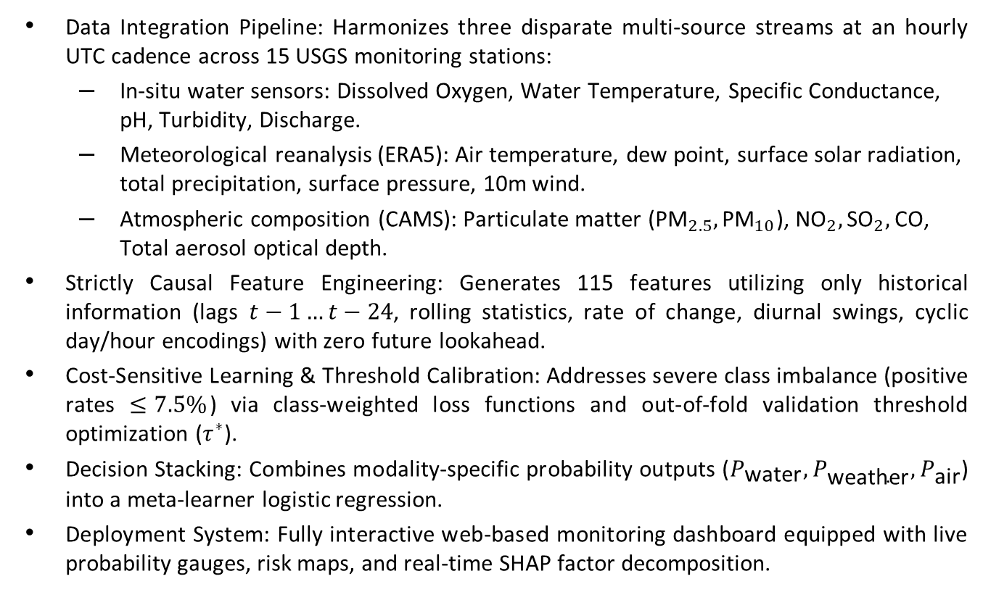
Proposed Work
Data Integration Pipeline: Harmonizes three disparate multi-source streams at an hourly UTC cadence across 15 USGS monitoring stations:
  In-situ water sensors: Dissolved Oxygen, Water Temperature, Specific Conductance, pH, Turbidity, Discharge.
  Meteorological reanalysis (ERA5): Air temperature, dew point, surface solar radiation, total precipitation, surface pressure, 10m wind.
  Atmospheric composition (CAMS): Particulate matter (${\text{PM}}_{2.5},{\text{PM}}_{10}$), ${\text{NO}}_{2},{\text{SO}}_{2},\text{CO}$, Total aerosol optical depth.
Strictly Causal Feature Engineering: Generates 115 features utilizing only historical information (lags $t−1…t−24$, rolling statistics, rate of change, diurnal swings, cyclic day/hour encodings) with zero future lookahead.
Cost-Sensitive Learning & Threshold Calibration: Addresses severe class imbalance (positive rates $≤7.5\%$) via class-weighted loss functions and out-of-fold validation threshold optimization ($τ^{∗}$).
Decision Stacking: Combines modality-specific probability outputs ($P_{\text{water}},P_{\text{weather}},P_{\text{air}}$) into a meta-learner logistic regression.
Deployment System: Fully interactive web-based monitoring dashboard equipped with live probability gauges, risk maps, and real-time SHAP factor decomposition.

Slide 9
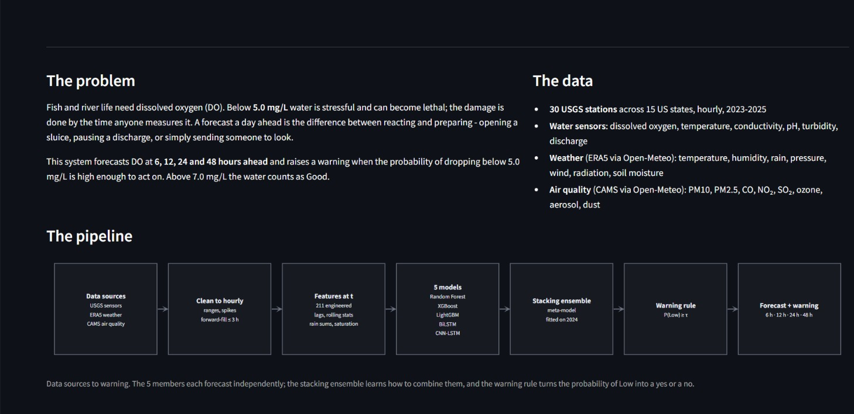
Proposed Work: Problem vs Data & Pipeline

Slide 10
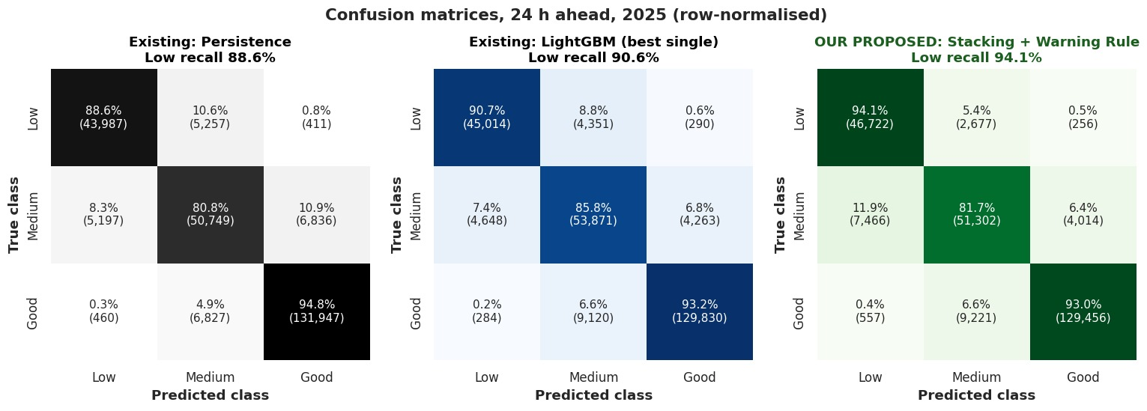
Proposed Work: Confusion matrix

Slide 11
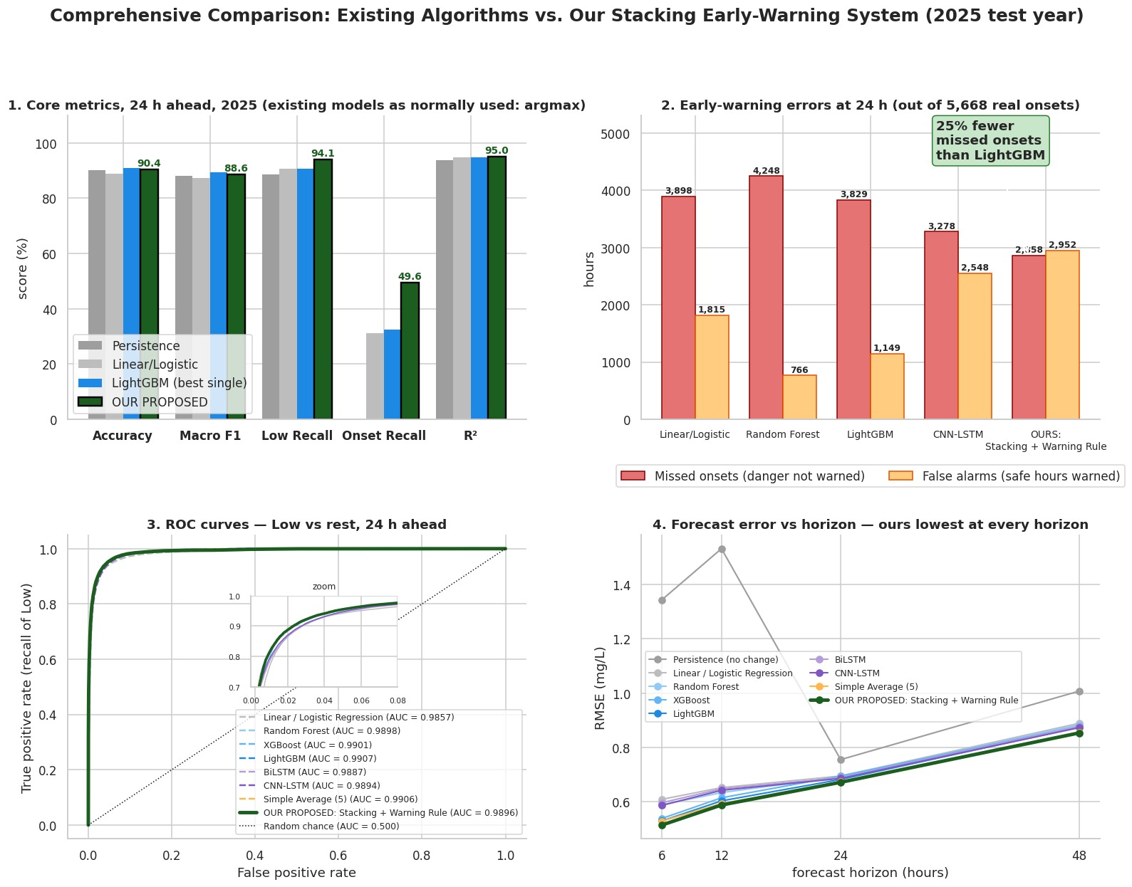
Proposed Work: Comparison

Slide 12
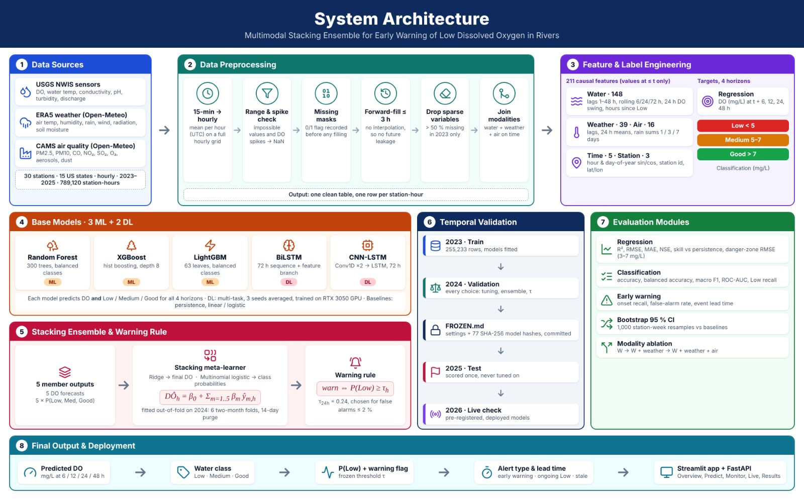
System Architecture

Slide 13
Modules
The system is decomposed into six modular components:
Module 1: Multi-Source Ingestion & Data Harmonization
Module 2: Causal Preprocessing & Quality Control
Module 3: Feature Engineering & Precondition-Gated Event Labeling
Module 4: Early & Late Multimodal Model Training
Module 5: Decision Threshold Optimization & Lead-Time Quantification
Module 6: Explainable AI & Interactive Dashboard Deployment

Slide 14
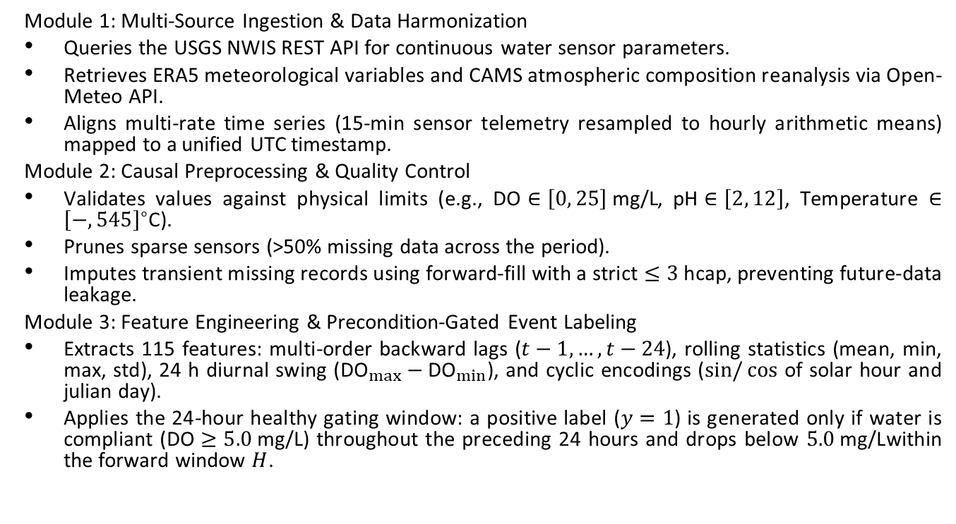
Module Description
Module 1: Multi-Source Ingestion & Data Harmonization
Queries the USGS NWIS REST API for continuous water sensor parameters.
Retrieves ERA5 meteorological variables and CAMS atmospheric composition reanalysis via Open-Meteo API.
Aligns multi-rate time series (15-min sensor telemetry resampled to hourly arithmetic means) mapped to a unified UTC timestamp.
Module 2: Causal Preprocessing & Quality Control
Validates values against physical limits (e.g., $\text{DO}∈\left[0 , 25\right]\text{ mg/L}$, $\text{pH}∈\left[2 , 12\right]$, Temperature $∈{\left[− , 545\right]}^{∘}\text{C}$).
Prunes sparse sensors (>50% missing data across the period).
Imputes transient missing records using forward-fill with a strict $≤3\text{ h}$cap, preventing future-data leakage.
Module 3: Feature Engineering & Precondition-Gated Event Labeling
Extracts 115 features: multi-order backward lags ($t−1,…,t−24$), rolling statistics (mean, min, max, std), 24 h diurnal swing (${\text{DO}}_{max}−{\text{DO}}_{min}$), and cyclic encodings ($\sin{/}cos$ of solar hour and julian day).
Applies the 24-hour healthy gating window: a positive label ($y=1$) is generated only if water is compliant ($\text{DO}≥5.0\text{ mg/L}$) throughout the preceding 24 hours and drops below $5.0\text{ mg/L}$within the forward window $H$.

Slide 15
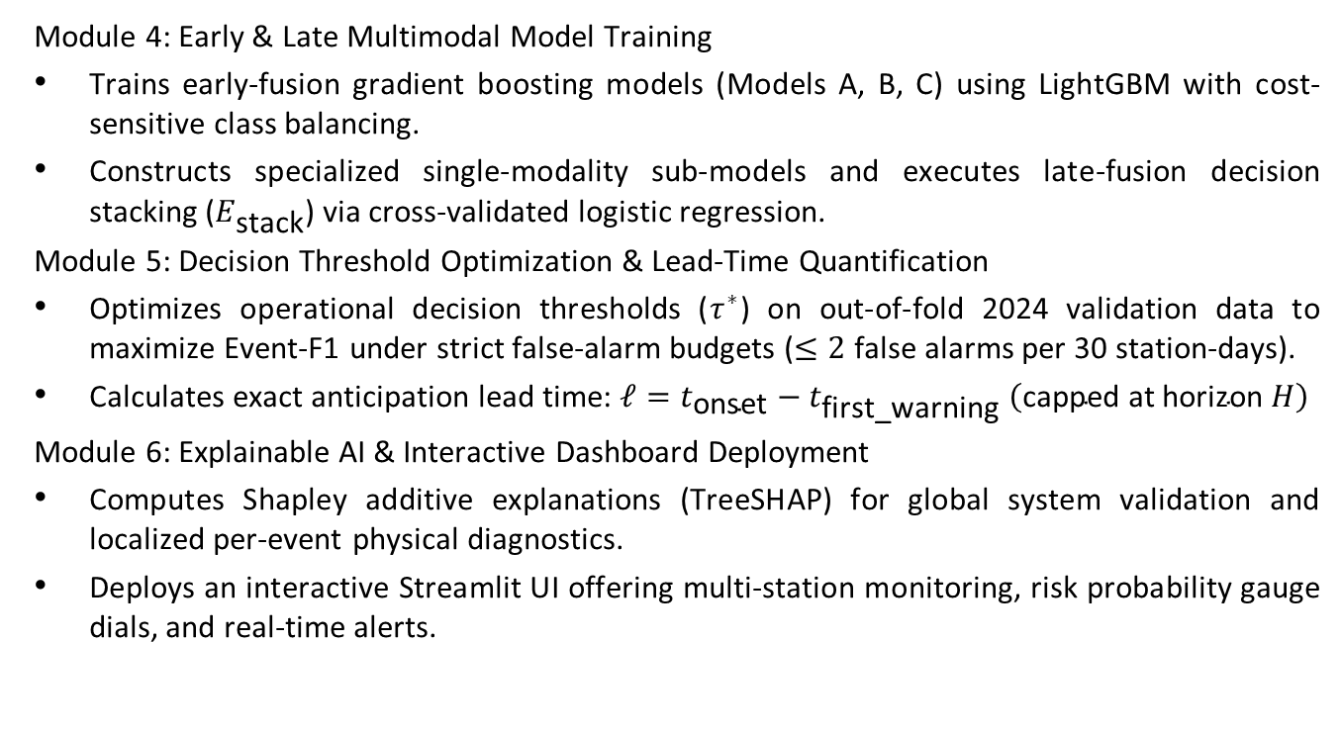
Module Description
Module 4: Early & Late Multimodal Model Training
Trains early-fusion gradient boosting models (Models A, B, C) using LightGBM with cost-sensitive class balancing.
Constructs specialized single-modality sub-models and executes late-fusion decision stacking ($E_{\text{stack}}$) via cross-validated logistic regression.
Module 5: Decision Threshold Optimization & Lead-Time Quantification
Optimizes operational decision thresholds ($τ^{∗}$) on out-of-fold 2024 validation data to maximize Event-F1 under strict false-alarm budgets ($≤2$ false alarms per 30 station-days).
Calculates exact anticipation lead time: $ℓ=t_{\text{onset}}−t_{\text{first}\text{_}\text{warning}} \left(\text{capped at horizon }H\right)$
Module 6: Explainable AI & Interactive Dashboard Deployment
Computes Shapley additive explanations (TreeSHAP) for global system validation and localized per-event physical diagnostics.
Deploys an interactive Streamlit UI offering multi-station monitoring, risk probability gauge dials, and real-time alerts.

Slide 16
Algorithm Formulation
Algorithm 1: Causal Feature & Preconditioned Event-Onset Generation
Input : Multi-source hourly time series X_raw(t), Dissolved Oxygen DO(t), Horizon H in {6,12,24,48}
Output: Feature matrix X(t) with 115 features, Binary target y_H(t)
1. For each station s and timestamp t:
2. Compute hydrological lags: DO(t-1), DO(t-2), ..., DO(t-24)
3. Compute rolling metrics over W = 24 hours:
DO_min = min(DO(t-W : t)), DO_mean = mean(DO(t-W : t)), DO_std = std(DO(t-W : t))
DO_swing = max(DO(t-W : t)) - min(DO(t-W : t))
4. Compute cumulative meteorological forcing: Rain_sum_6h, Rain_sum_24h, Solar_radiation_24h
5. Compute cyclic time encodings:
sin_hour = sin(2*pi*hour/24), cos_hour = cos(2*pi*hour/24)
sin_day = sin(2*pi*doy/365), cos_day = cos(2*pi*doy/365)
6. Assemble causal feature vector X(t) in R^115
7. Evaluate Precondition:
Is_Healthy(t) = 1 if min(DO(t-24 : t)) >= 5.0 mg/L else 0
8. Evaluate Future Deterioration:
Future_Depletion(t) = 1 if min(DO(t+1 : t+H)) < 5.0 mg/L else 0
9. Assign Target:
y_H(t) = 1 if (Is_Healthy(t) == 1 and Future_Depletion(t) == 1) else 0
10. Return X(t), y_H(t)

Slide 17
Algorithm Formulation
Algorithm 2: Stacked Late-Fusion Ensemble & Lead-Time Optimization
Input : Training set D_train (2023), Validation set D_val (2024), Frozen Test set D_test (2025)
Output: Calibrated probability P_E(t), Warning binary decision W(t), Lead time ell
1. Train Modality-Specific Base Classifiers on D_train:
M_water <- LightGBM(X_water, y)
M_weather <- LightGBM(X_weather, y)
M_air <- LightGBM(X_air, y)
2. Generate Out-of-Fold Probability Predictions on D_val:
P_water(t), P_weather(t), P_air(t)
3. Train Late-Fusion Logistic Regression Meta-Learner:
P_E(t) = sigma( beta_0 + beta_w * P_water(t) + beta_m * P_weather(t) + beta_a * P_air(t) )
4. Grid-search optimal threshold tau* on D_val:
tau* = argmax_{tau in [0.1, 0.9]} F1_event(P_E(t) >= tau)
5. Freeze all weights beta, hyper-parameters, and tau* (Commit SHA-256 hashes to FROZEN.md)
6. Evaluate ONCE on Holdout D_test (2025):
For each timestamp t where Is_Healthy(t) == 1:
Issue Warning: W(t) = 1 if P_E(t) >= tau* else 0
If W(t) == 1 and actual onset occurs at t_onset:
Lead time ell = min(t_onset - t, H)
7. Return P_E(t), W(t), ell

Slide 18
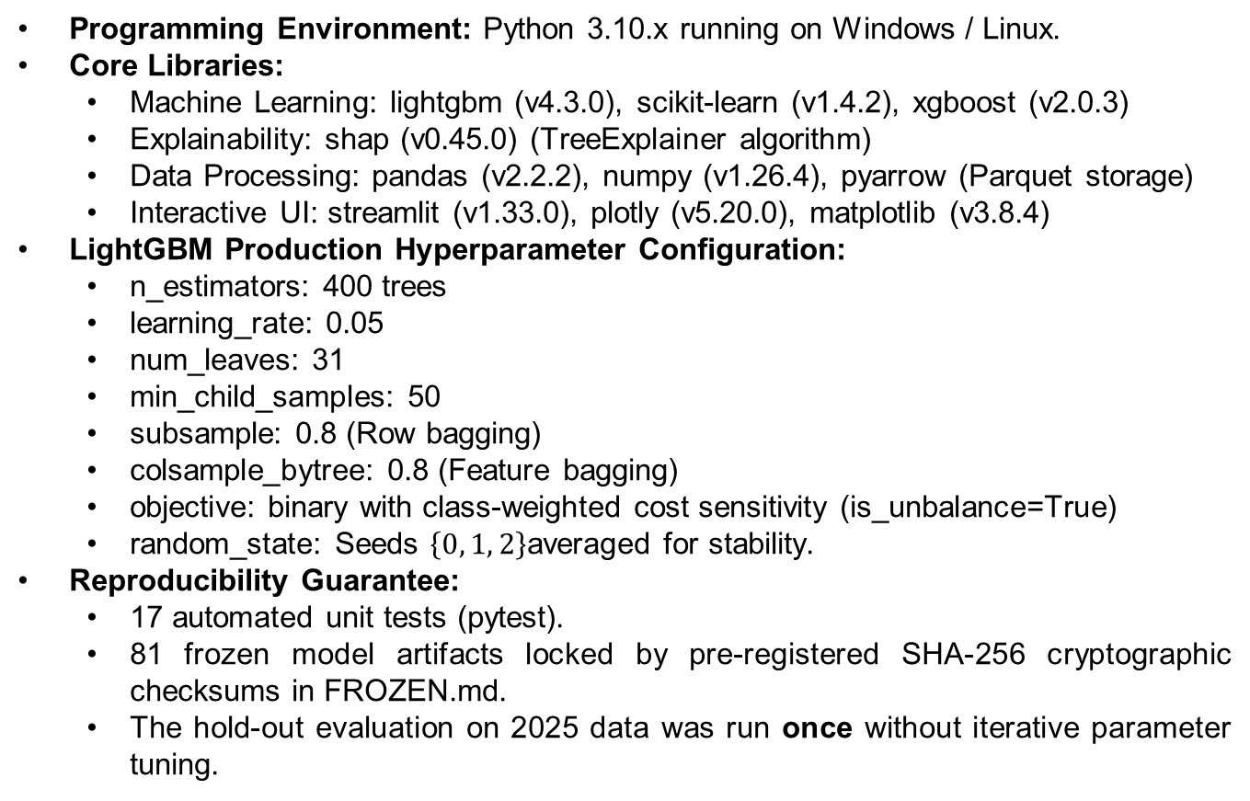
Implementation Details
Programming Environment: Python 3.10.x running on Windows / Linux.
Core Libraries:
  Machine Learning: lightgbm (v4.3.0), scikit-learn (v1.4.2), xgboost (v2.0.3)
  Explainability: shap (v0.45.0) (TreeExplainer algorithm)
  Data Processing: pandas (v2.2.2), numpy (v1.26.4), pyarrow (Parquet storage)
  Interactive UI: streamlit (v1.33.0), plotly (v5.20.0), matplotlib (v3.8.4)
LightGBM Production Hyperparameter Configuration:
  n_estimators: 400 trees
  learning_rate: 0.05
  num_leaves: 31
  min_child_samples: 50
  subsample: 0.8 (Row bagging)
  colsample_bytree: 0.8 (Feature bagging)
  objective: binary with class-weighted cost sensitivity (is_unbalance=True)
  random_state: Seeds $\left\{0 , 1 , 2\right\}$averaged for stability.
Reproducibility Guarantee:
  17 automated unit tests (pytest).
  81 frozen model artifacts locked by pre-registered SHA-256 cryptographic checksums in FROZEN.md.
  The hold-out evaluation on 2025 data was run once without iterative parameter tuning.

Slide 19
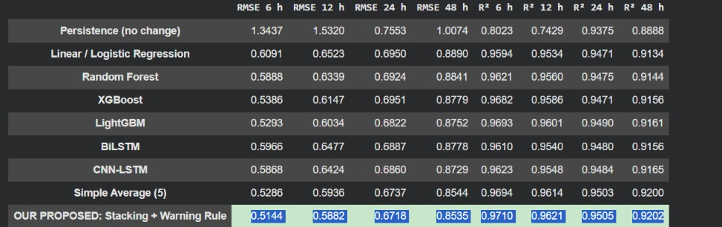
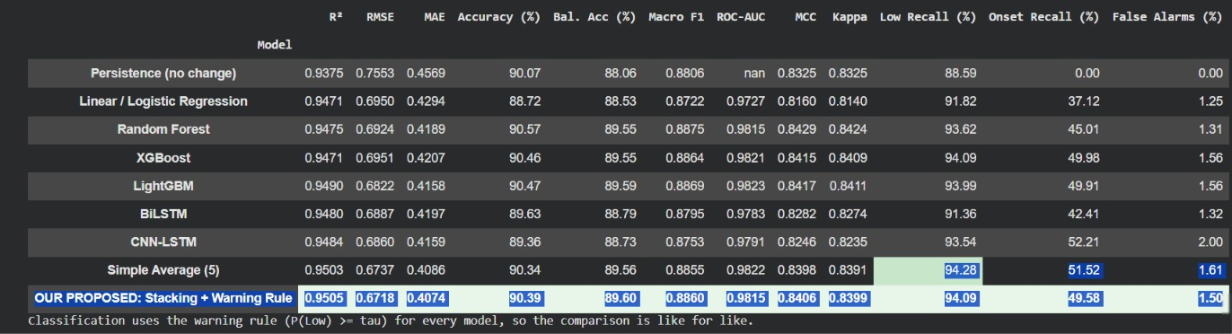
Implementation Details

Slide 20
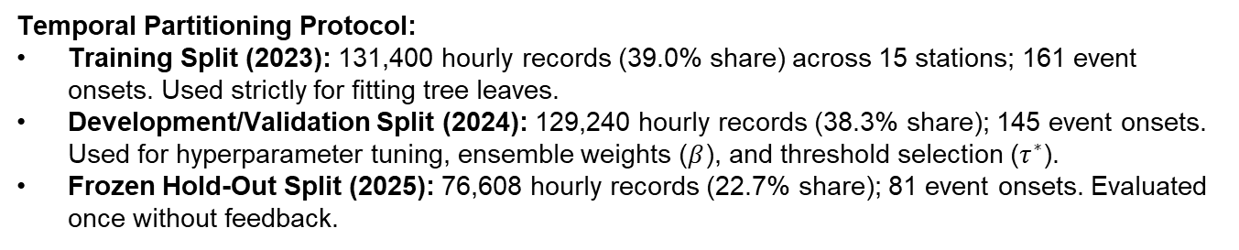
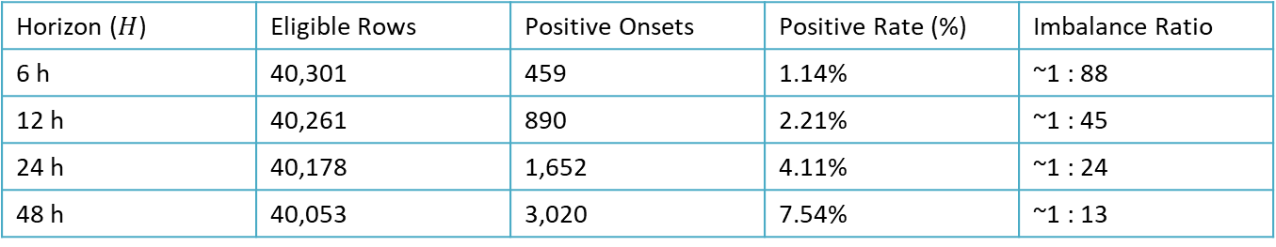
Results & Discussion — Dataset Splits & Class Balance
Temporal Partitioning Protocol:
Training Split (2023): 131,400 hourly records (39.0% share) across 15 stations; 161 event onsets. Used strictly for fitting tree leaves.
Development/Validation Split (2024): 129,240 hourly records (38.3% share); 145 event onsets. Used for hyperparameter tuning, ensemble weights ($β$), and threshold selection ($τ^{∗}$).
Frozen Hold-Out Split (2025): 76,608 hourly records (22.7% share); 81 event onsets. Evaluated once without feedback.
Class Imbalance Distribution (2025 Hold-Out Set):
Horizon ($H$) | Eligible Rows | Positive Onsets | Positive Rate (%) | Imbalance Ratio
6 h | 40,301 | 459 | 1.14% | ~1 : 88
12 h | 40,261 | 890 | 2.21% | ~1 : 45
24 h | 40,178 | 1,652 | 4.11% | ~1 : 24
48 h | 40,053 | 3,020 | 7.54% | ~1 : 13

Slide 21
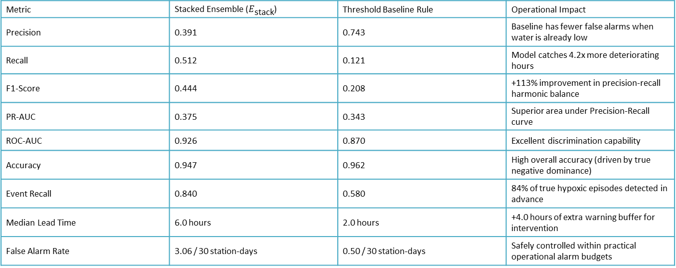
Results & Discussion — Dataset Splits & Class Balance And Model Evaluation at 24-Hour Horizon
Feature Breakdown (115 total columns): Water sensors (USGS NWIS): 80 features (70%)
Weather reanalysis (ERA5): 15 features (13%)
Air quality (CAMS): 16 features (14%)
Temporal encodings: 4 features (3%)
Comprehensive benchmarking of the Stacked Late-Fusion Ensemble ($E_{\text{stack}}$) against the standard industrial Threshold Baseline (${\text{DO}}_{t}<5.1\text{ mg/L}$) on the unseen 2025 hold-out:
Metric | Stacked Ensemble ($E_{\text{stack}}$) | Threshold Baseline Rule | Operational Impact
Precision | 0.391 | 0.743 | Baseline has fewer false alarms when water is already low
Recall | 0.512 | 0.121 | Model catches 4.2x more deteriorating hours
F1-Score | 0.444 | 0.208 | +113% improvement in precision-recall harmonic balance
PR-AUC | 0.375 | 0.343 | Superior area under Precision-Recall curve
ROC-AUC | 0.926 | 0.870 | Excellent discrimination capability
Accuracy | 0.947 | 0.962 | High overall accuracy (driven by true negative dominance)
Event Recall | 0.840 | 0.580 | 84% of true hypoxic episodes detected in advance
Median Lead Time | 6.0 hours | 2.0 hours | +4.0 hours of extra warning buffer for intervention
False Alarm Rate | 3.06 / 30 station-days | 0.50 / 30 station-days | Safely controlled within practical operational alarm budgets

Slide 22
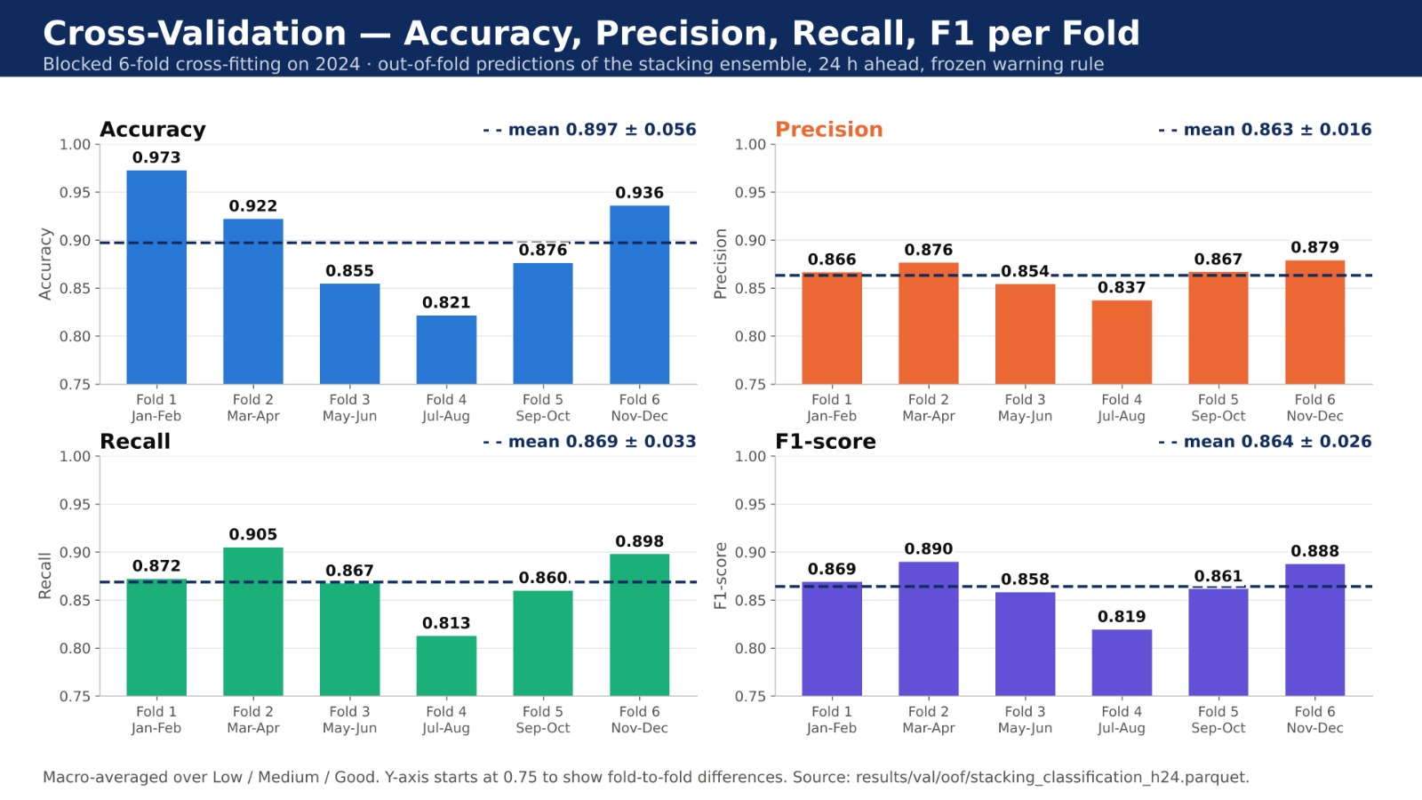
Results & Discussion — Dataset Splits & Class Balance And Model Evaluation at 24-Hour Horizon

Slide 23
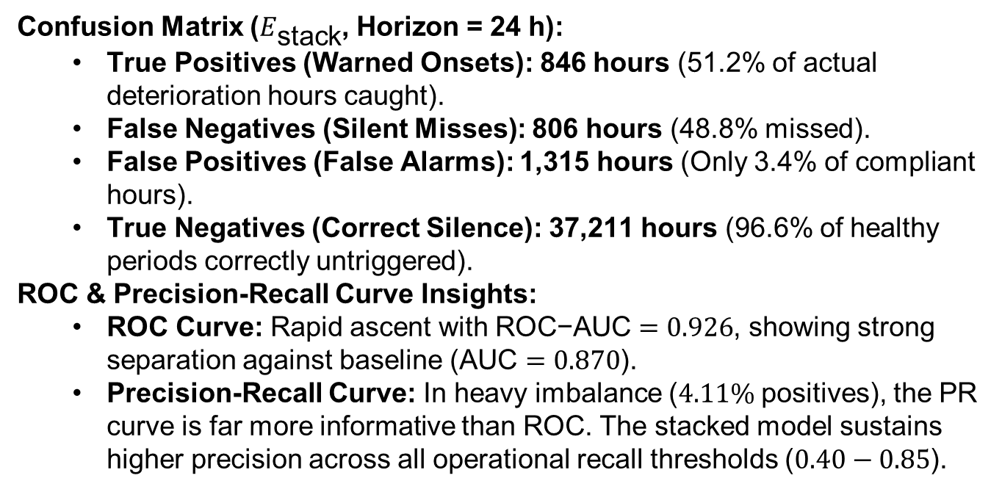
Results & Discussion — Confusion Matrix & ROC/PR Curves
Confusion Matrix ($E_{\text{stack}}$, Horizon = 24 h):
  True Positives (Warned Onsets): 846 hours (51.2% of actual deterioration hours caught).
  False Negatives (Silent Misses): 806 hours (48.8% missed).
  False Positives (False Alarms): 1,315 hours (Only 3.4% of compliant hours).
  True Negatives (Correct Silence): 37,211 hours (96.6% of healthy periods correctly untriggered).
ROC & Precision-Recall Curve Insights:
  ROC Curve: Rapid ascent with $\text{ROC−AUC}=0.926$, showing strong separation against baseline ($\text{AUC}=0.870$).
  Precision-Recall Curve: In heavy imbalance ($4.11\%$ positives), the PR curve is far more informative than ROC. The stacked model sustains higher precision across all operational recall thresholds ($0.40−0.85$).

Slide 24
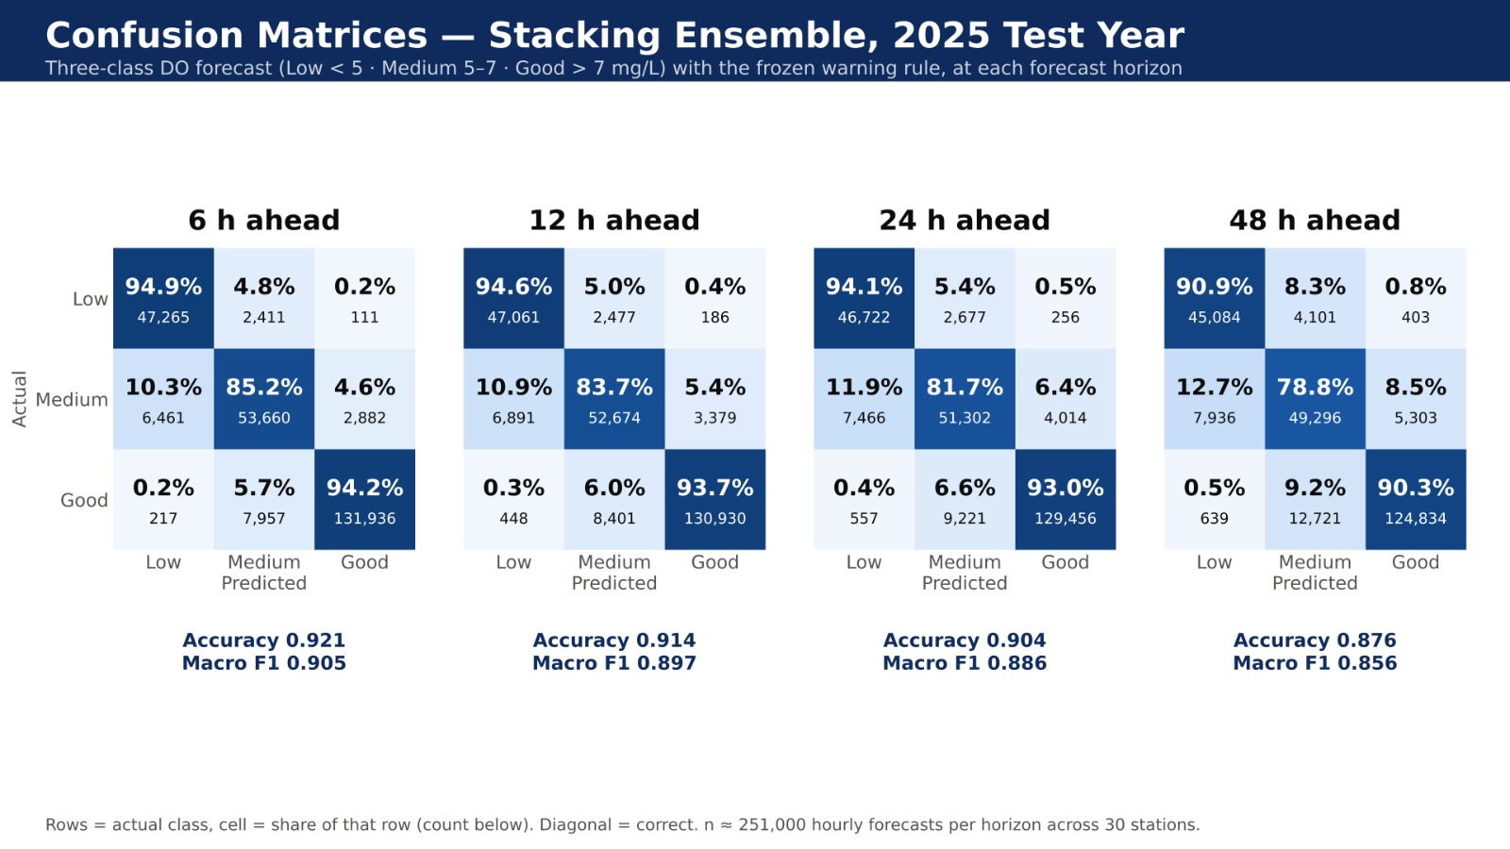
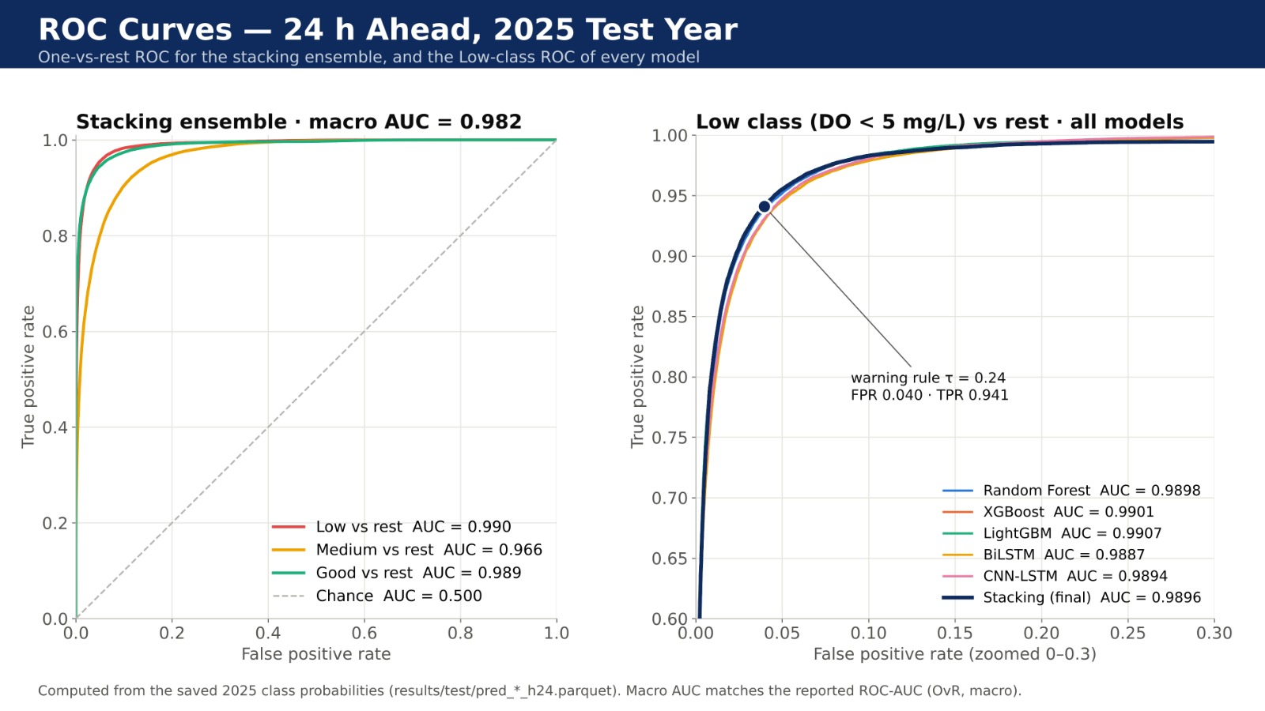
Results & Discussion — Confusion Matrix & ROC/PR Curves

Slide 25
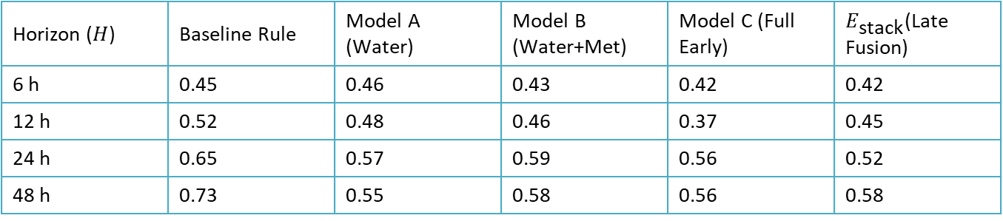
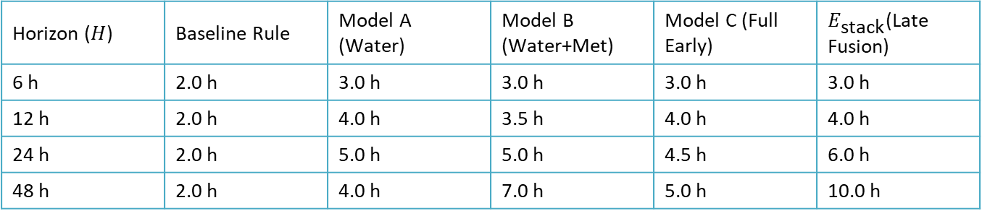
Results & Discussion — Modality Ablation Study
Controlled ablation study comparing the Baseline, Model A (Water-only), Model B (Water + Weather), Model C (Water + Weather + Air), and $E_{\text{stack}}$(Stacked Late Fusion):
Event F1-Score Across Horizons
Horizon ($H$) | Baseline Rule | Model A (Water) | Model B (Water+Met) | Model C (Full Early) | $E_{\text{stack}}$(Late Fusion)
6 h | 0.45 | 0.46 | 0.43 | 0.42 | 0.42
12 h | 0.52 | 0.48 | 0.46 | 0.37 | 0.45
24 h | 0.65 | 0.57 | 0.59 | 0.56 | 0.52
48 h | 0.73 | 0.55 | 0.58 | 0.56 | 0.58
Median Anticipation Lead Time (Hours)
Horizon ($H$) | Baseline Rule | Model A (Water) | Model B (Water+Met) | Model C (Full Early) | $E_{\text{stack}}$(Late Fusion)
6 h | 2.0 h | 3.0 h | 3.0 h | 3.0 h | 3.0 h
12 h | 2.0 h | 4.0 h | 3.5 h | 4.0 h | 4.0 h
24 h | 2.0 h | 5.0 h | 5.0 h | 4.5 h | 6.0 h
48 h | 2.0 h | 4.0 h | 7.0 h | 5.0 h | 10.0 h

Slide 26
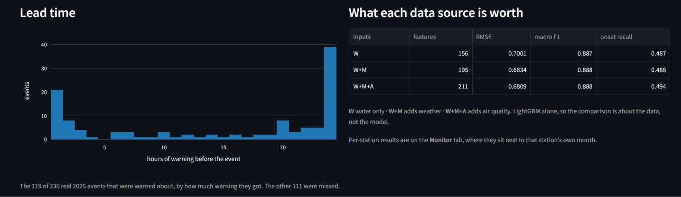
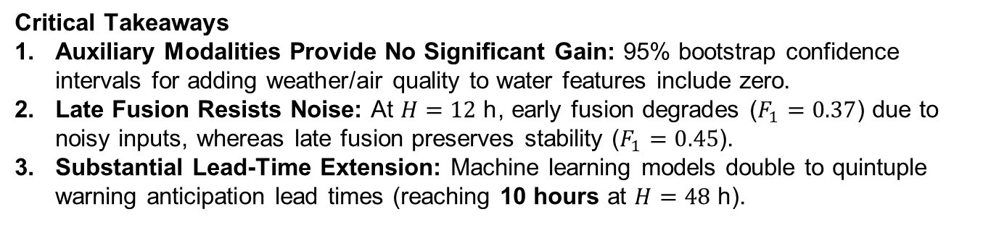
Results & Discussion — Modality Ablation Study
Critical Takeaways
Auxiliary Modalities Provide No Significant Gain: 95% bootstrap confidence intervals for adding weather/air quality to water features include zero.
Late Fusion Resists Noise: At $H=12\text{ h}$, early fusion degrades ($F_{1}=0.37$) due to noisy inputs, whereas late fusion preserves stability ($F_{1}=0.45$).
Substantial Lead-Time Extension: Machine learning models double to quintuple warning anticipation lead times (reaching 10 hours at $H=48\text{ h}$).

Slide 27
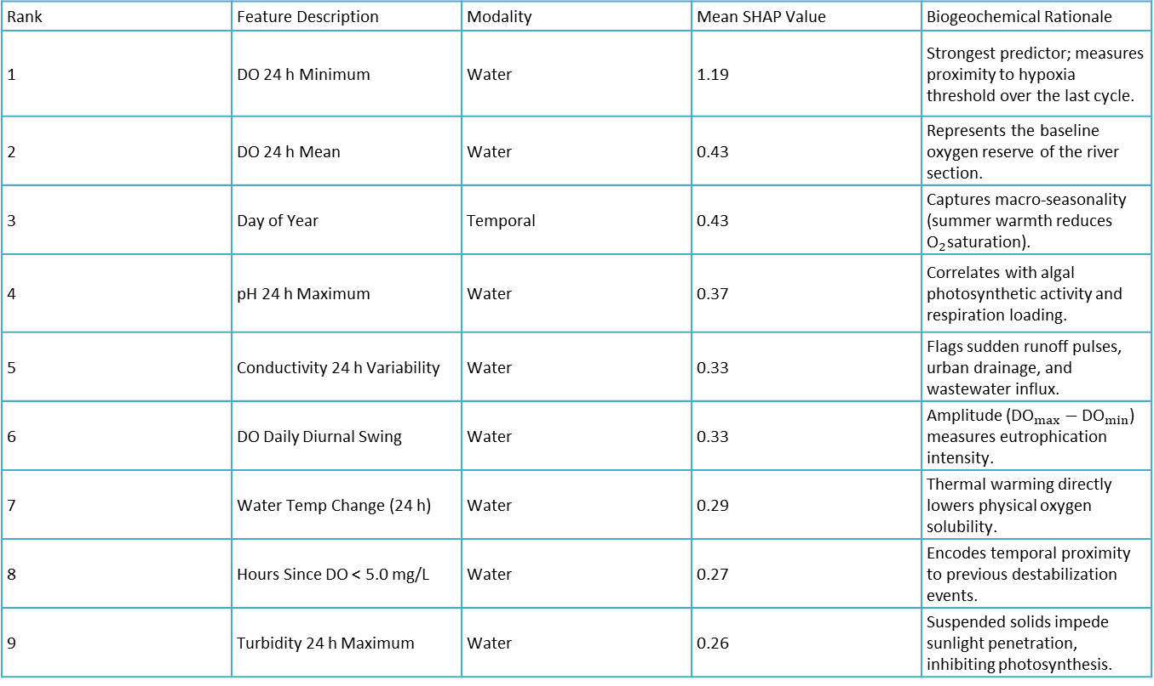
Results & Discussion — Global Feature Importance (SHAP)
Global Mean Absolute SHAP Value Analysis on Model A (Water Quality):
Rank | Feature Description | Modality | Mean SHAP Value | Biogeochemical Rationale
1 | DO 24 h Minimum | Water | 1.19 | Strongest predictor; measures proximity to hypoxia threshold over the last cycle.
2 | DO 24 h Mean | Water | 0.43 | Represents the baseline oxygen reserve of the river section.
3 | Day of Year | Temporal | 0.43 | Captures macro-seasonality (summer warmth reduces ${\text{O}}_{2}$saturation).
4 | pH 24 h Maximum | Water | 0.37 | Correlates with algal photosynthetic activity and respiration loading.
5 | Conductivity 24 h Variability | Water | 0.33 | Flags sudden runoff pulses, urban drainage, and wastewater influx.
6 | DO Daily Diurnal Swing | Water | 0.33 | Amplitude (${\text{DO}}_{max}−{\text{DO}}_{min}$) measures eutrophication intensity.
7 | Water Temp Change (24 h) | Water | 0.29 | Thermal warming directly lowers physical oxygen solubility.
8 | Hours Since DO < 5.0 mg/L | Water | 0.27 | Encodes temporal proximity to previous destabilization events.
9 | Turbidity 24 h Maximum | Water | 0.26 | Suspended solids impede sunlight penetration, inhibiting photosynthesis.

Slide 28
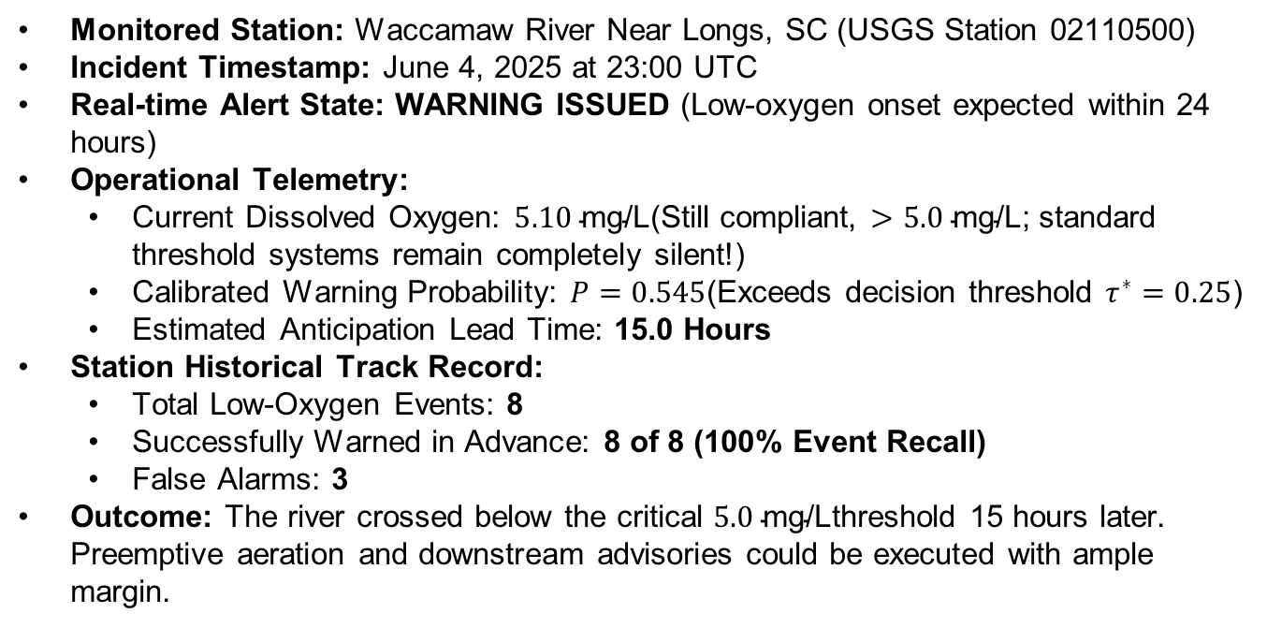
Results & Discussion — Case Study: Live Event Prediction
Monitored Station: Waccamaw River Near Longs, SC (USGS Station 02110500)
Incident Timestamp: June 4, 2025 at 23:00 UTC
Real-time Alert State: WARNING ISSUED (Low-oxygen onset expected within 24 hours)
Operational Telemetry:
  Current Dissolved Oxygen: $5.10\text{ mg/L}$(Still compliant, $>5.0\text{ mg/L}$; standard threshold systems remain completely silent!)
  Calibrated Warning Probability: $P=0.545$(Exceeds decision threshold $τ^{∗}=0.25$)
  Estimated Anticipation Lead Time: 15.0 Hours
Station Historical Track Record:
  Total Low-Oxygen Events: 8
  Successfully Warned in Advance: 8 of 8 (100% Event Recall)
  False Alarms: 3
Outcome: The river crossed below the critical $5.0\text{ mg/L}$threshold 15 hours later. Preemptive aeration and downstream advisories could be executed with ample margin.

Slide 29
Results & Discussion — Local XAI: Warning Factor Decomposition
Local SHAP waterfall attribution for the June 4, 2025 alert at Waccamaw River:
Feature / Factor | Real-Time Reading | Training Median (Baseline) | Source | Local SHAP Attribution | Physical Risk Interpretation
DO 24 h Minimum | 5.00 mg/L | 6.85 mg/L | Water | +7.11 | Oxygen dipped dangerously close to limit during recent nocturnal trough.
Current DO | 5.10 mg/L | 7.60 mg/L | Water | +1.69 | Ambient concentration is severely depressed below normal seasonal levels.
DO 24 h Mean | 5.06 mg/L | 7.60 mg/L | Water | +0.69 | Cumulative biological demand is outpacing daily photosynthetic reaeration.
pH | 6.10 | 7.60 | Water | +0.62 | Acidic drift indicates elevated decomposition and dissolved carbon dioxide.
Day of Year | 0.46 (June) | 0.26 (March) | Time | +0.60 | Summer conditions; elevated temperature accelerates microbial oxygen uptake.

Slide 30
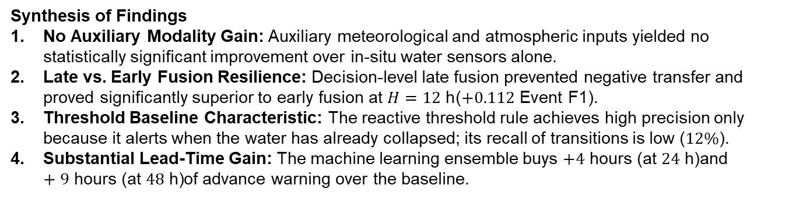
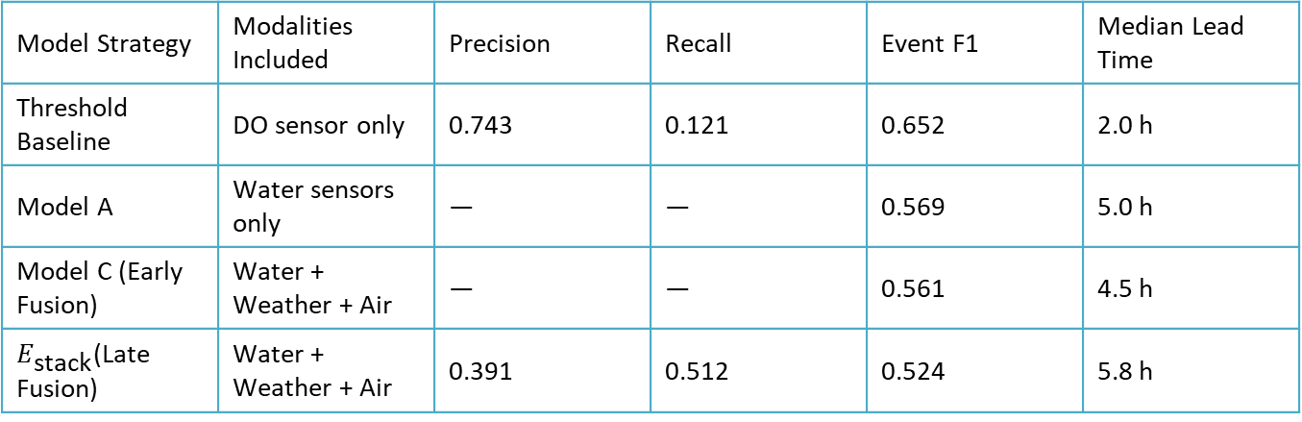
Results & Discussion — Performance on 2025 Holdout Set (H=24 h)
Model Strategy | Modalities Included | Precision | Recall | Event F1 | Median Lead Time
Threshold Baseline | DO sensor only | 0.743 | 0.121 | 0.652 | 2.0 h
Model A | Water sensors only | — | — | 0.569 | 5.0 h
Model C (Early Fusion) | Water + Weather + Air | — | — | 0.561 | 4.5 h
$E_{\text{stack}}$(Late Fusion) | Water + Weather + Air | 0.391 | 0.512 | 0.524 | 5.8 h
Synthesis of Findings
No Auxiliary Modality Gain: Auxiliary meteorological and atmospheric inputs yielded no statistically significant improvement over in-situ water sensors alone.
Late vs. Early Fusion Resilience: Decision-level late fusion prevented negative transfer and proved significantly superior to early fusion at $H=12\text{ h}$($+0.112\text{ Event F1}$).
Threshold Baseline Characteristic: The reactive threshold rule achieves high precision only because it alerts when the water has already collapsed; its recall of transitions is low ($12\%$).
Substantial Lead-Time Gain: The machine learning ensemble buys $+4\text{ hours (at }24\text{ h)}$and $+9\text{ hours (at }48\text{ h)}$of advance warning over the baseline.

Slide 31
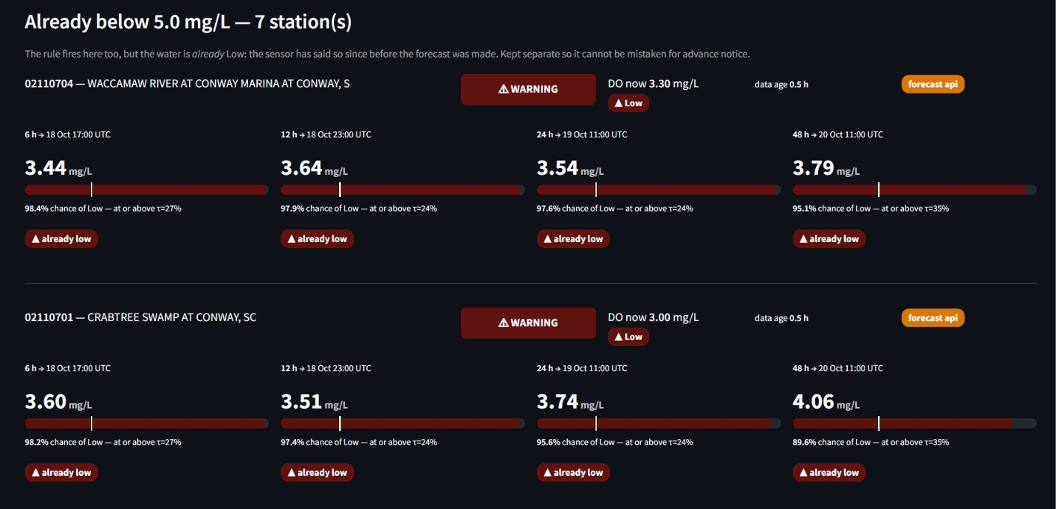
Results & Discussion

Slide 32
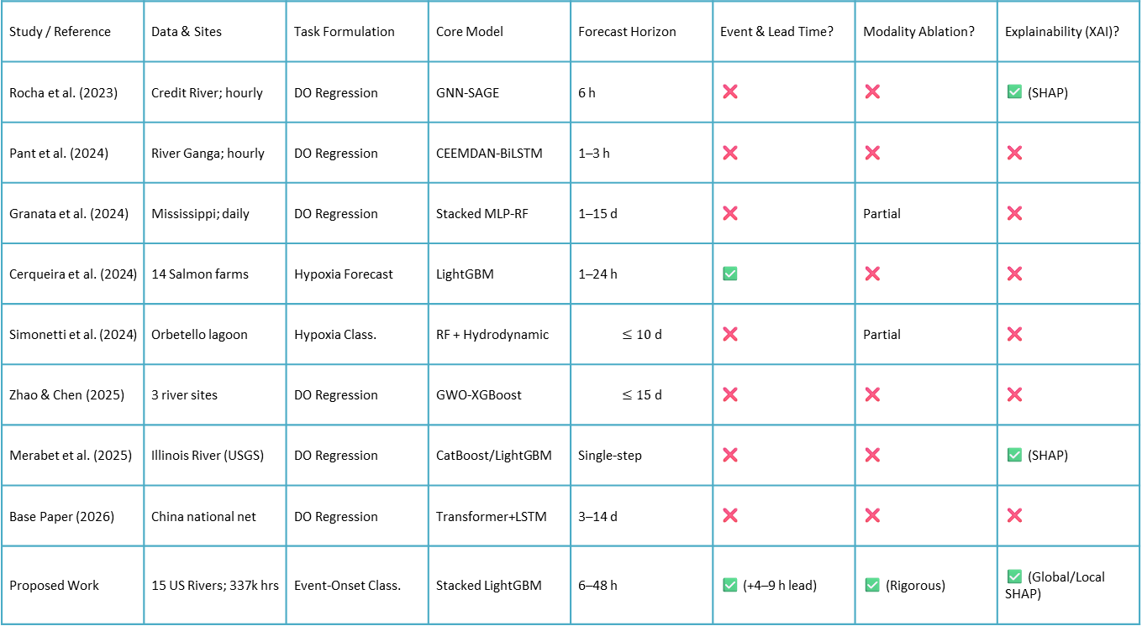
Results & Discussion — Comparison with Existing Work
Study / Reference | Data & Sites | Task Formulation | Core Model | Forecast Horizon | Event & Lead Time? | Modality Ablation? | Explainability (XAI)?
Rocha et al. (2023) | Credit River; hourly | DO Regression | GNN-SAGE | 6 h | ❌ | ❌ | ✅ (SHAP)
Pant et al. (2024) | River Ganga; hourly | DO Regression | CEEMDAN-BiLSTM | 1–3 h | ❌ | ❌ | ❌
Granata et al. (2024) | Mississippi; daily | DO Regression | Stacked MLP-RF | 1–15 d | ❌ | Partial | ❌
Cerqueira et al. (2024) | 14 Salmon farms | Hypoxia Forecast | LightGBM | 1–24 h | ✅ | ❌ | ❌
Simonetti et al. (2024) | Orbetello lagoon | Hypoxia Class. | RF + Hydrodynamic | $$≤10\text{ d}$$ | ❌ | Partial | ❌
Zhao & Chen (2025) | 3 river sites | DO Regression | GWO-XGBoost | $$≤15\text{ d}$$ | ❌ | ❌ | ❌
Merabet et al. (2025) | Illinois River (USGS) | DO Regression | CatBoost/LightGBM | Single-step | ❌ | ❌ | ✅ (SHAP)
Base Paper (2026) | China national net | DO Regression | Transformer+LSTM | 3–14 d | ❌ | ❌ | ❌
Proposed Work | 15 US Rivers; 337k hrs | Event-Onset Class. | Stacked LightGBM | 6–48 h | ✅ (+4–9 h lead) | ✅ (Rigorous) | ✅ (Global/Local SHAP)

Slide 33
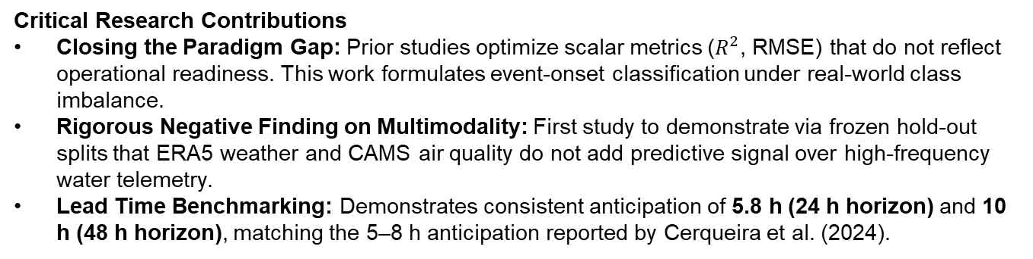
Results & Discussion — Comparison with Existing Work
Critical Research Contributions
Closing the Paradigm Gap: Prior studies optimize scalar metrics ($R^{2}$, RMSE) that do not reflect operational readiness. This work formulates event-onset classification under real-world class imbalance.
Rigorous Negative Finding on Multimodality: First study to demonstrate via frozen hold-out splits that ERA5 weather and CAMS air quality do not add predictive signal over high-frequency water telemetry.
Lead Time Benchmarking: Demonstrates consistent anticipation of 5.8 h (24 h horizon) and 10 h (48 h horizon), matching the 5–8 h anticipation reported by Cerqueira et al. (2024).

Slide 34
Conclusion
Framework Delivery: Developed, validated, and deployed an end-to-end multimodal machine learning system for anticipatory dissolved-oxygen deterioration warning in rivers.
Modality Verdict: Empirical proof on an independent hold-out year shows that auxiliary weather and atmospheric inputs do not significantly enhance early detection beyond in-situ water sensors.
Architectural Advantage: Late fusion via logistic regression stacking exhibits superior noise resilience compared to early fusion concatenation.
Practical Utility: The proposed framework successfully extends operational warning lead times by 4 to 9 hours across 24 h and 48 h horizons, unlocking a critical window for proactive river basin management.
Interpretability: Integrated TreeSHAP diagnostics confirm that 24 h minimum DO, seasonality, and diurnal swings drive deterioration risk.
Methodological Rigor: Demonstrated that strict temporal partitioning is essential; development-set cross-validation systematically overestimates hold-out generalizability.

Slide 35
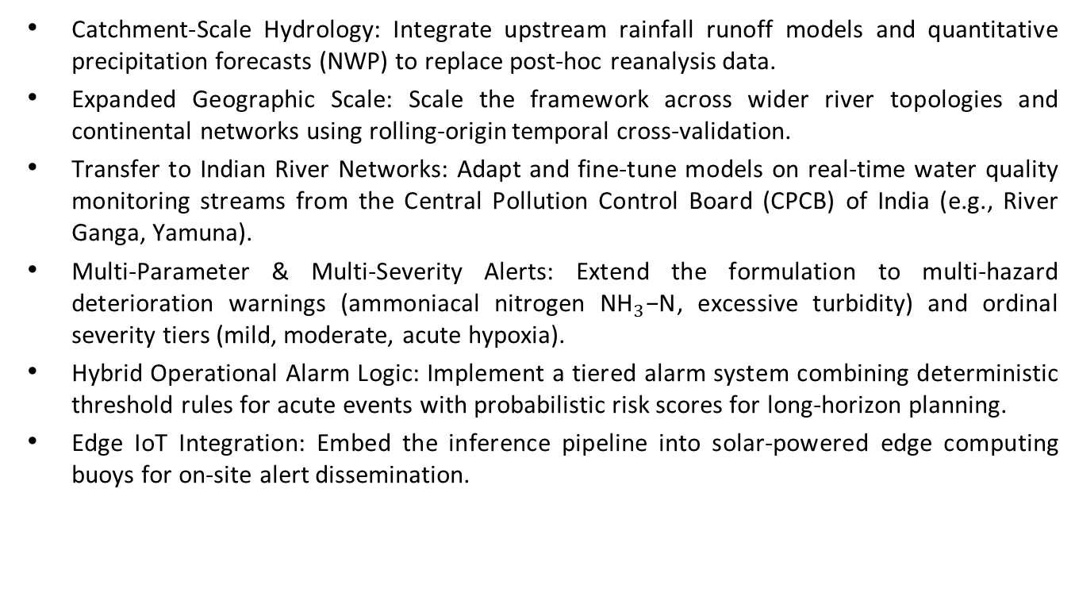
Future Work
Catchment-Scale Hydrology: Integrate upstream rainfall runoff models and quantitative precipitation forecasts (NWP) to replace post-hoc reanalysis data.
Expanded Geographic Scale: Scale the framework across wider river topologies and continental networks using rolling-origin temporal cross-validation.
Transfer to Indian River Networks: Adapt and fine-tune models on real-time water quality monitoring streams from the Central Pollution Control Board (CPCB) of India (e.g., River Ganga, Yamuna).
Multi-Parameter & Multi-Severity Alerts: Extend the formulation to multi-hazard deterioration warnings (ammoniacal nitrogen ${\text{NH}}_{3}\text{−N}$, excessive turbidity) and ordinal severity tiers (mild, moderate, acute hypoxia).
Hybrid Operational Alarm Logic: Implement a tiered alarm system combining deterministic threshold rules for acute events with probabilistic risk scores for long-horizon planning.
Edge IoT Integration: Embed the inference pipeline into solar-powered edge computing buoys for on-site alert dissemination.

Slide 36
References
J. Moon, J. Lee, S. Lee, and H. Yoon, "Urban river dissolved oxygen prediction model using machine learning," Water, vol. 14, no. 12, p. 1899, 2022.
P. A. C. Rocha, V. O. Santos, J. Van Griensven Thé, and B. Gharabaghi, "New graph-based and transformer deep learning models for river dissolved oxygen forecasting," Environments, vol. 10, no. 12, p. 217, 2023.
N. Pant, D. Toshniwal, and B. R. Gurjar, "Multi-step forecasting of dissolved oxygen in River Ganga based on CEEMDAN-AdaBoost-BiLSTM-LSTM model," Scientific Reports, vol. 14, p. 11199, 2024.
F. Granata, S. Zhu, and F. Di Nunno, "Dissolved oxygen forecasting in the Mississippi River: advanced ensemble machine learning models," Royal Society of Chemistry, doi: 10.1039/D4VA00119B, 2024.
V. Cerqueira et al., "Forecasting ocean hypoxia in salmonid fish farms," Frontiers in Aquaculture, vol. 3, p. 1365123, 2024.
I. Simonetti, C. Lubello, and L. Cappietti, "On the use of hydrodynamic modelling and random forest classifiers for the prediction of hypoxia in coastal lagoons," Science of the Total Environment, vol. 951, p. 175424, 2024.
Y. Zhao and M. Chen, "Prediction of river dissolved oxygen (DO) based on multi-source data and various machine learning coupling models," PLOS ONE, vol. 20, no. 3, p. e0319256, 2025.
K. Merabet et al., "Predicting water quality variables using gradient boosting machine: global versus local explainability using SHapley Additive Explanations (SHAP)," Earth Science Informatics, vol. 18, p. 298, 2025.
R. Choudhary et al., "Predicting water quality index using stacked ensemble regression and SHAP based explainable artificial intelligence," Scientific Reports, vol. 15, p. 31139, 2025.
"Multimodal deep-learning–driven water-quality forecasting and scenario assessment: shifting from reactive monitoring to proactive basin management," Journal of Hydrology, 2026.
G. Ke et al., "LightGBM: A highly efficient gradient boosting decision tree," Advances in Neural Information Processing Systems (NeurIPS), 2017.
S. M. Lundberg and S.-I. Lee, "A unified approach to interpreting model predictions," NeurIPS, 2017.
D. H. Wolpert, "Stacked generalization," Neural Networks, vol. 5, no. 2, pp. 241–259, 1992.
T. Saito and M. Rehmsmeier, "The precision-recall plot is more informative than the ROC plot when evaluating binary classifiers on imbalanced datasets," PLOS ONE, vol. 10, no. 3, p. e0118432, 2015.
H. Hersbach et al., "The ERA5 global reanalysis," Quarterly Journal of the Royal Meteorological Society, vol. 146, no. 730, pp. 1999–2049, 2020.
A. Inness et al., "The CAMS reanalysis of atmospheric composition," Atmospheric Chemistry and Physics, vol. 19, pp. 3515–3556, 2019.
U.S. Geological Survey, "National Water Information System (NWIS)," waterdata.usgs.gov.
U.S. Environmental Protection Agency, "Ambient water quality criteria for dissolved oxygen," EPA 440/5-86-003, 1986.

